Slide 1
Hive Products
Tom Pankonen
Honey Pimp Apiaries

Slide 2
Hive Products
Honey
Pollen
Propolis
Royal Jelly
Wax
Queens

Slide 3
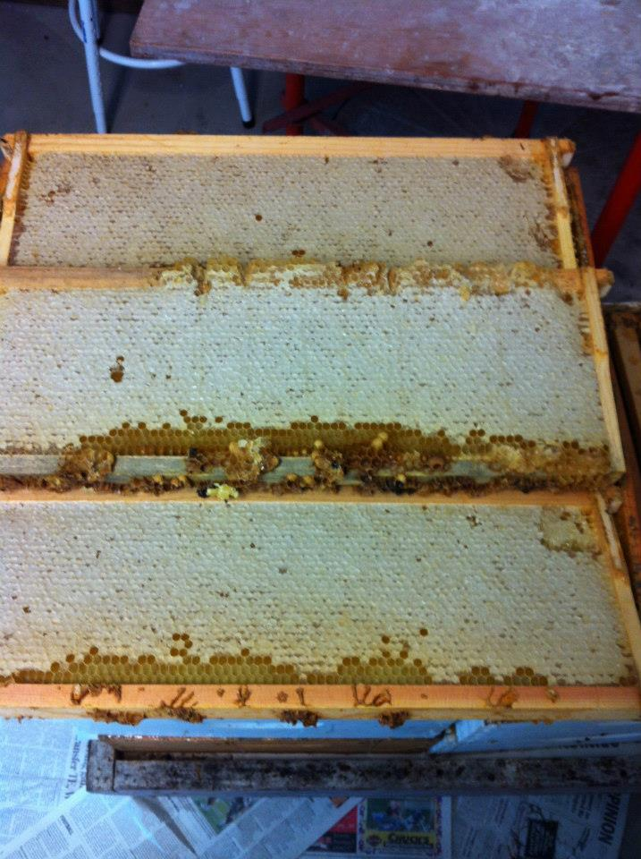
honey
Honey Pimp Apiaries

Slide 4
Honey
Extracted
Comb
Chunk
Creamed

Slide 5
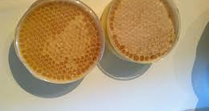
Comb Honey
glaciercountyhoney.wordpress.com

Slide 6
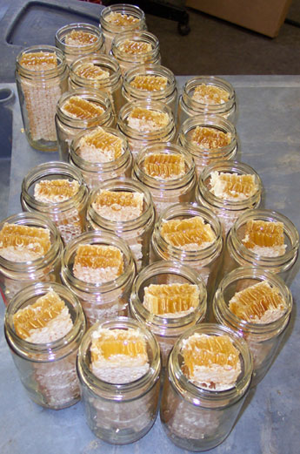
Chunk honey
glaciercountyhoney.wordpress.com

Slide 7
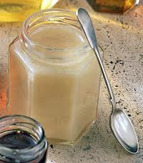
Creamed honey
indianahoney.com

Slide 8
Pollen
Allergy treatment
Carbs, Proteins, minerals
Collected at specific times using traps

Slide 9
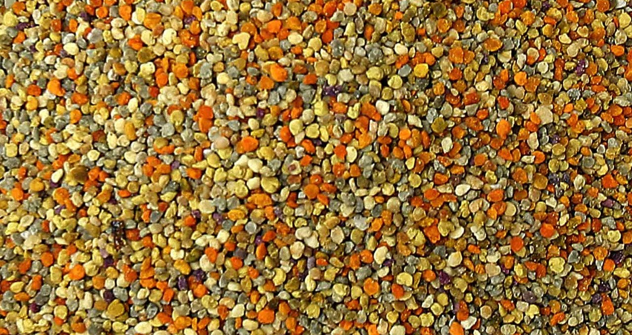
Pollen
excelmathmike.blogspot.com

Slide 10
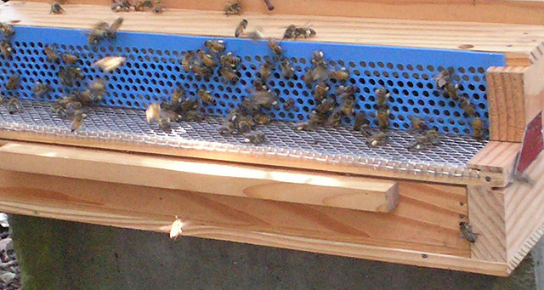
Pollen trap
flickr.com/photos/jomarietolentino/2568937855/

Slide 11
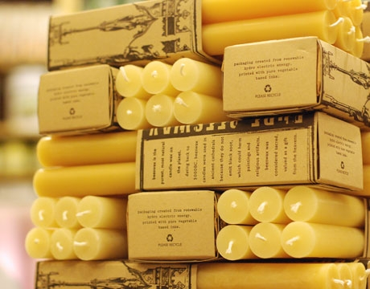
wax
orthodoxcandles.com/buying-beeswax-candles

Slide 12
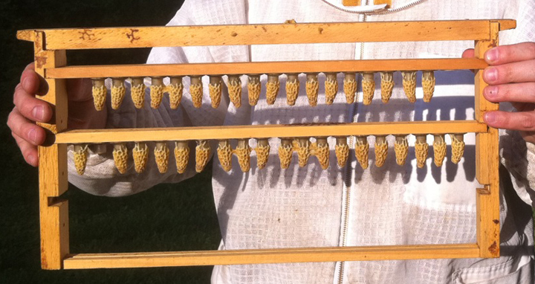
Queen rearing
threeriversbeekeepers.com/workshop/

Slide 13
Fermented Beverages
Mead
Bragget
Beer

Slide 14
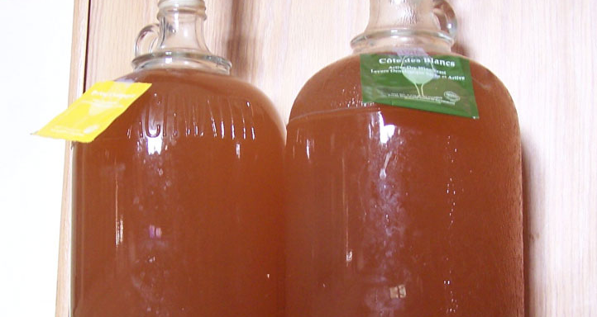
Mead
smallbeerpress.com/not-a-journal/2008/01/14/episode-6-mead/

Slide 15
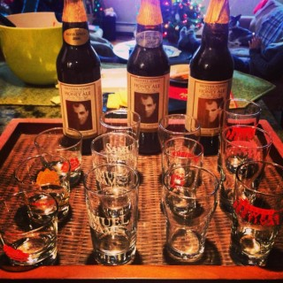
bragget
untappd.com/beer/59517

